Slide 1



UNIT 7;
Which way to go?
Self-check 7

Slide 2
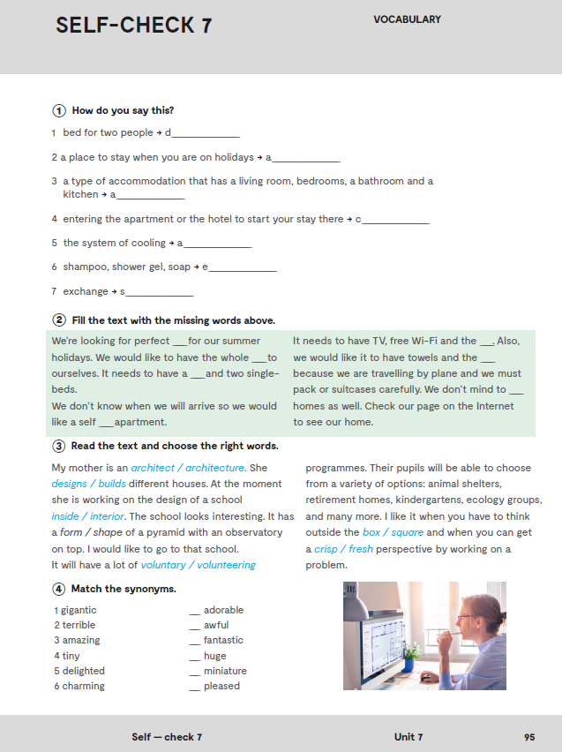
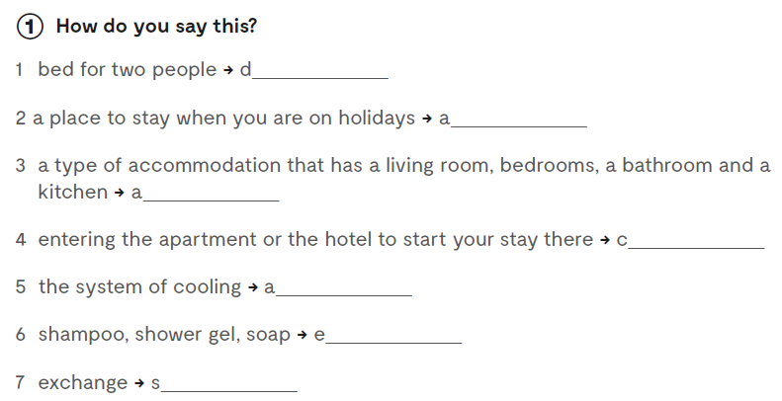
Workbook, p. 95
ouble-bed
ccommodation
partment
heck-in
ir conditioning
ssentials
wap

Slide 3
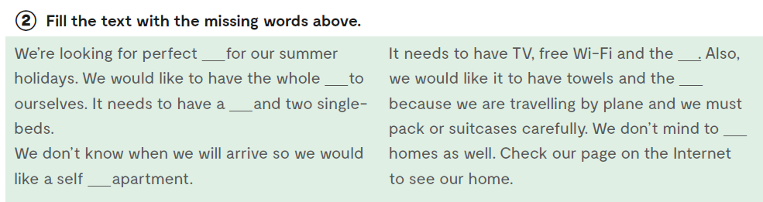
2
5
3
6
1
7
4

Slide 4
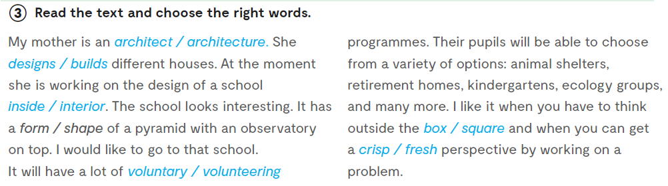


Slide 5
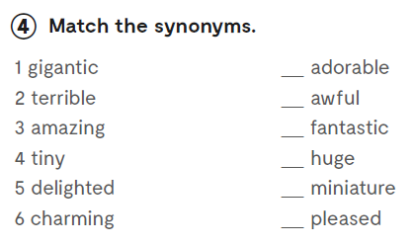
6
2
3
1
4
5

Slide 6
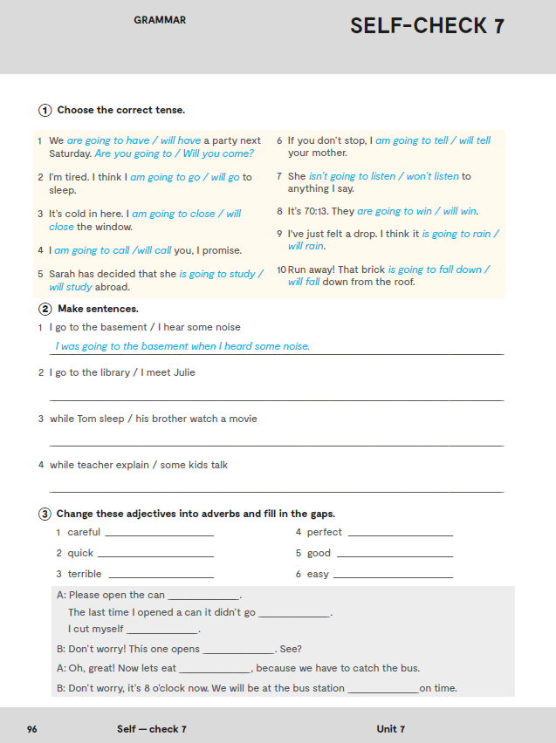
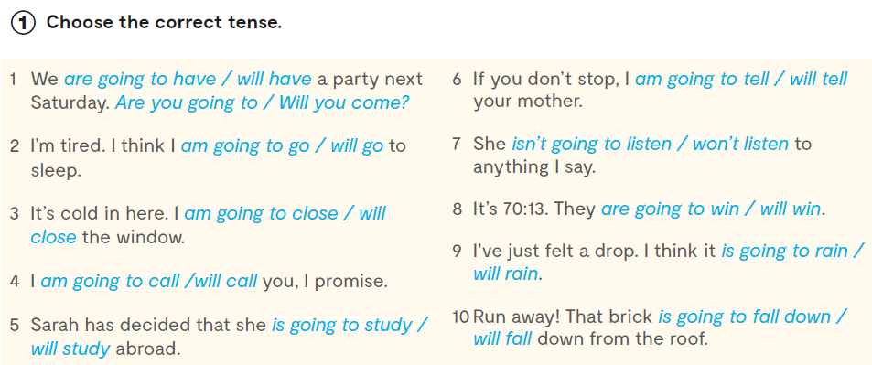
Let’s practise:
https://wordwall.net/play/889/200/436

Slide 7
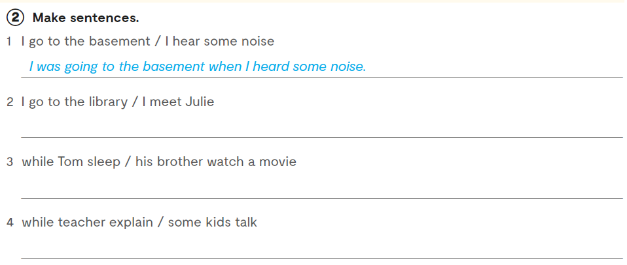
I was going to the library when I met Julie.
While Tom was sleeping, his brother was watching a movie.
While teacher was explaining, some kids were talking.

Slide 8
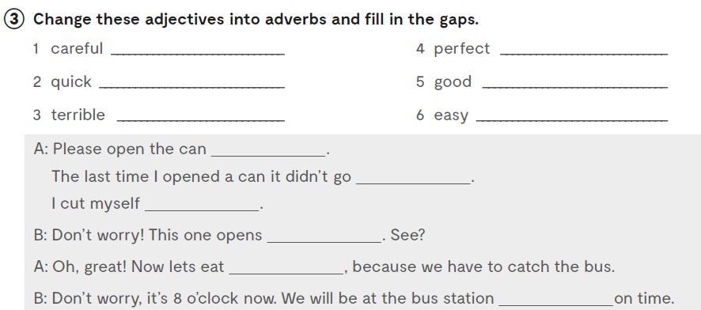
carefully
perfectly
quickly
well
terribly
easily
carefully
well
terribly
easily
quickly
perfectly

Slide 9
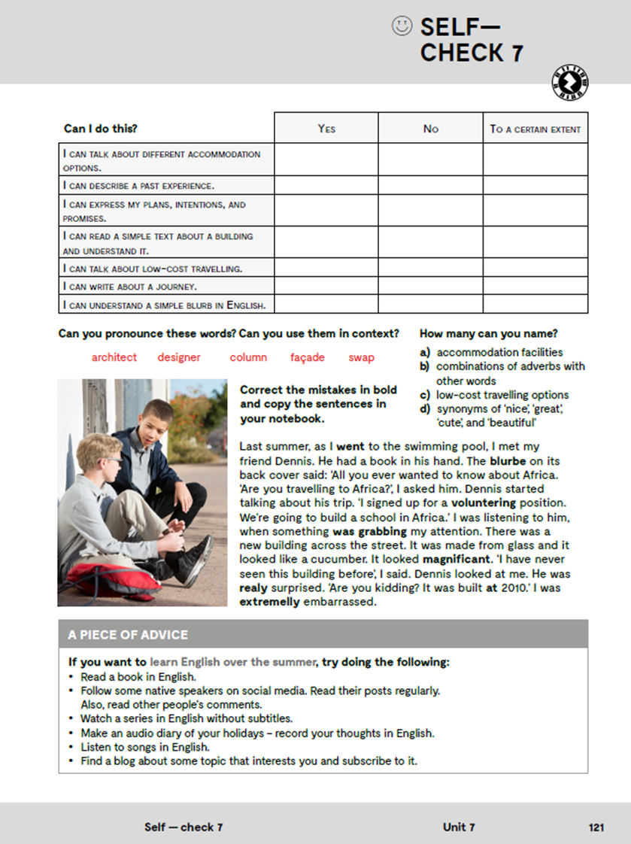

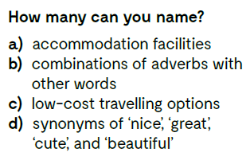

Slide 10

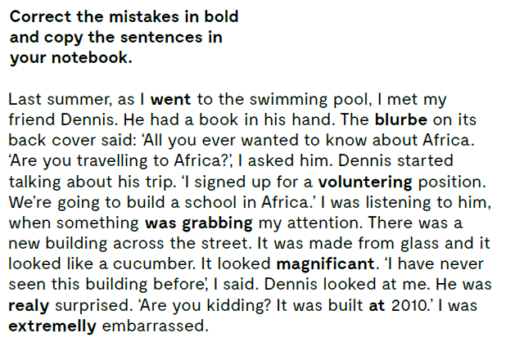

Slide 11
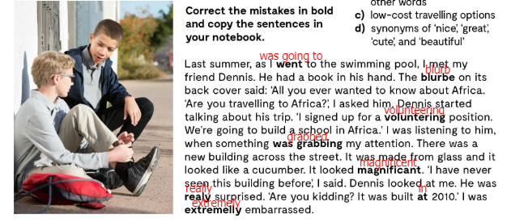
Let’s check!

Slide 12
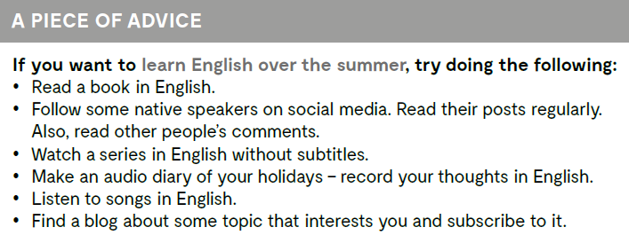

Slide 13
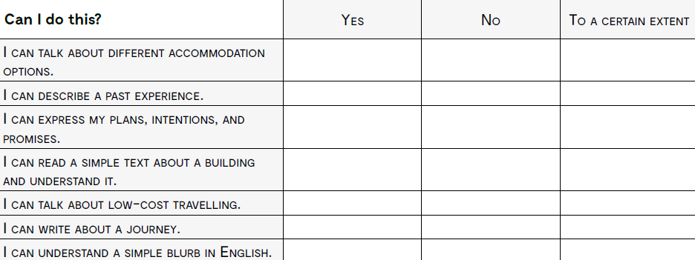
govoriti o različitim vrstama smještaja?
opisati iskustvo iz prošlosti?
izraziti planove, namjere i obećanja?
pročitati i razumjeti jednostavan tekst o građevinama?
govoriti o jeftinom putovanju?
pisati o putovanju?
razumjeti jednostavan blurb na engleskom jeziku?

